Slide 1



Chatbot – Personal Assistant
Minor project
Presented by –
Sharika Anjum Mondal
Prithivi Guha
Koustav Pal

Slide 2

Table of contents
Background Check
Process
Technicalities
Conclusion

Slide 3
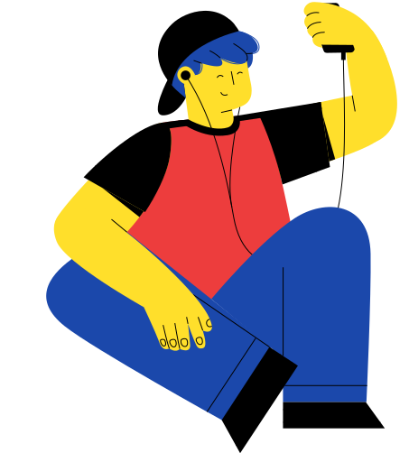
Background Check

Slide 4
The Problem
Now that individuals are spending more time in the virtual world as a result of the Covid19 pandemic, psychologists have discovered that 8 out of 10 people feel lonely sitting at home even while doing work for not getting to see their peers or close ones - which is specifically seen in older teens or young adults. Thus, we have devised an innovative method for dealing with people's loneliness by utilizing a deep learning chatbot.

Slide 5
The main importance of this personal chatbot is that it should be easily available to all with these basic features :
Objectives
Schedule meetings at proposed time.
Do small talks to help people overcome loneliness.
What we want to achieve

Slide 6

Process

Slide 7
Methodology
Step 01
Step 02
Step 03
Step 04
Intent Defining
Data Preparation
Model Training
Model Testing with real-time query
Step 05
Step 06
Creating the front-end and integrating it with the backend
Integrating with a Chatbot Framework to get the speech-to-text feature

Slide 8



Features
Small Talk – It’s often seen people love to converse with chatbots. In this virtual mode of living people,especially younger adults and older teens are often seen feeling lonely. This feature is basically kept for that purpose.
Appointment Scheduler – Again, keeping in mind these days, where we communicate via several virtual meetings, keeping a track on all the meetings become very difficult. That’s when this feature comes to play. Like – “hey! Schedule a meeting for me tomorrow at 4pm”.

Slide 9

Technicalities

Slide 10
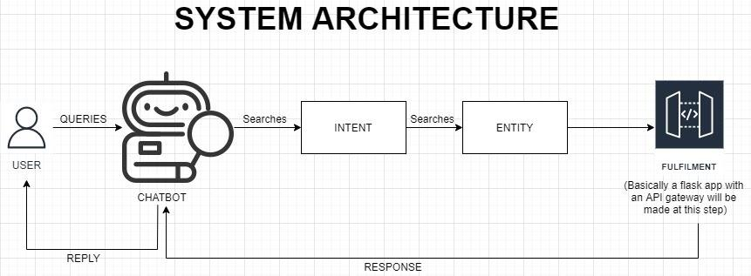
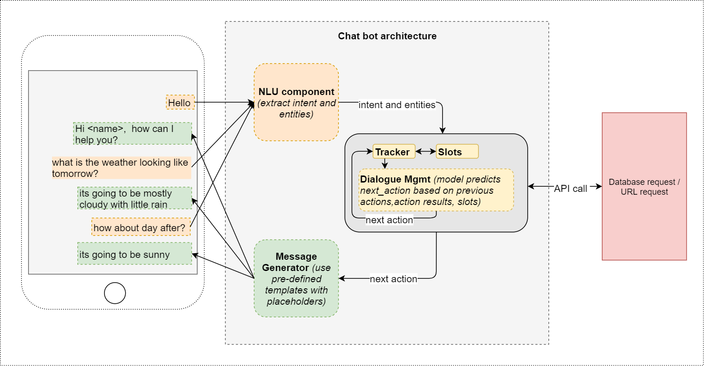
How a Chatbot Works?
System Working

Slide 11
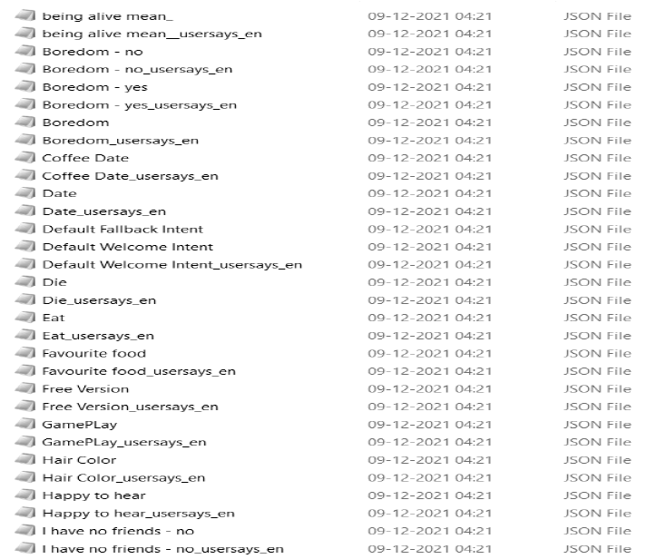
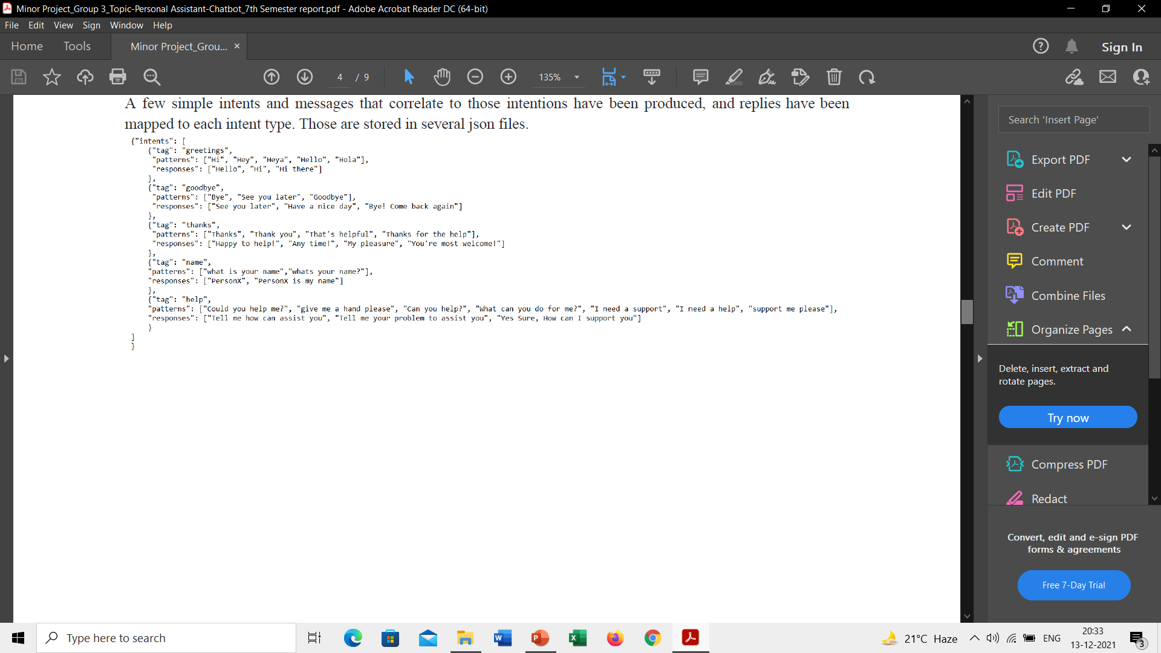
Intent Defining
Defining intents in json file format which will later be required in data preparation.

Slide 12
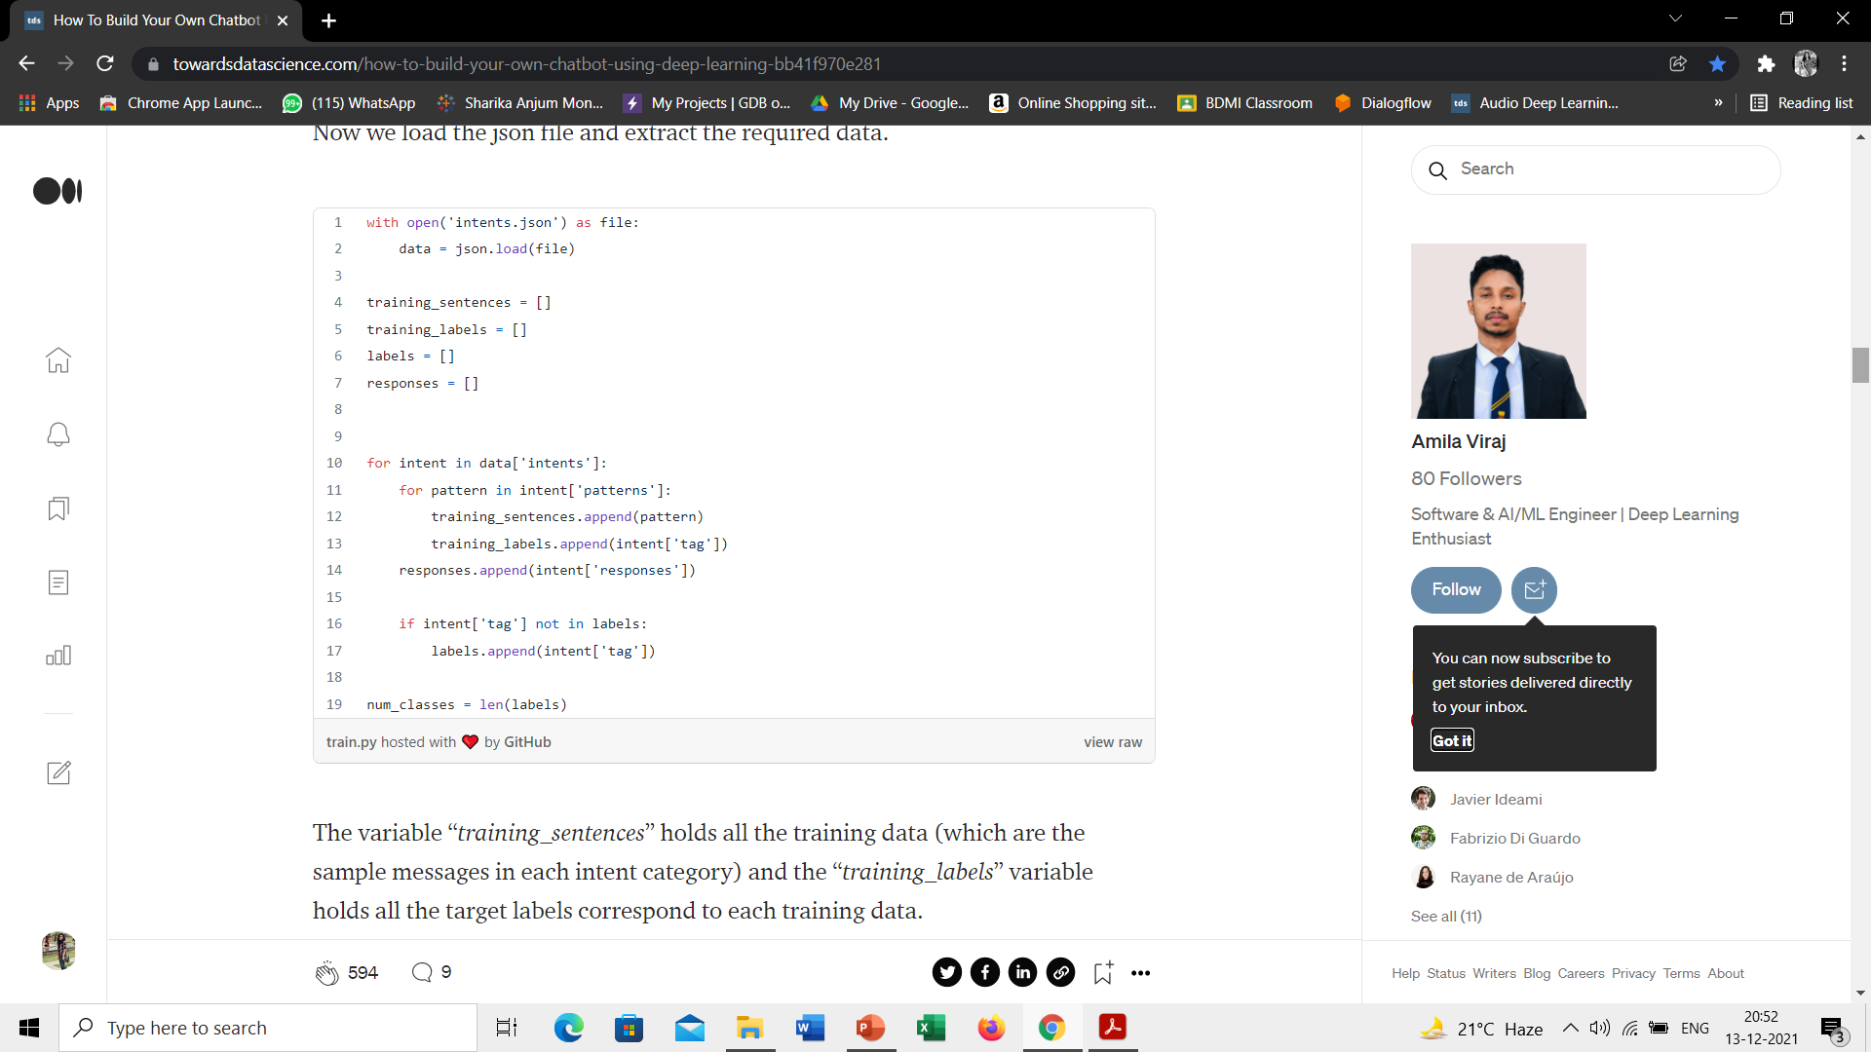
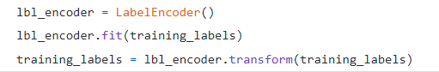
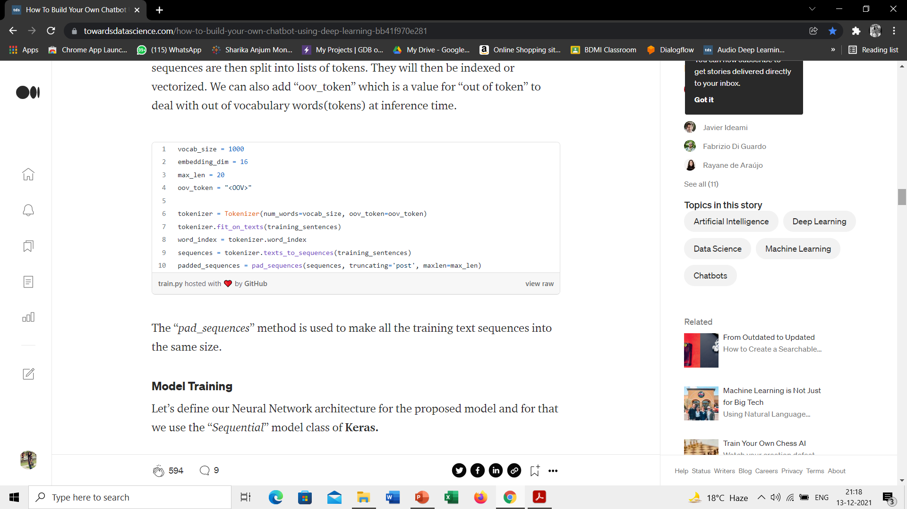
Data Preparation
Loading the json file and extracting the required data.
The variable “training_sentences” holds all the training data (which are the sample messages in each intent category) and the “training_labels” variable holds all the target labels correspond to each training data.
Then we use “LabelEncoder()” to convert the target labels into a model understandable form.
Next, we vectorize our text data corpus by using the “Tokenizer” class and it allows us to limit our vocabulary size up to some defined number. When we use this class for the text pre-processing task, by default all punctuations will be removed, turning the texts into space-separated sequences of words, and these sequences are then split into lists of tokens. They will then be indexed or vectorized. We can also add “oov_token” which is a value for “out of token” to deal with out of vocabulary words(tokens) at inference time.
The “pad_sequences” method is used to make all the training text sequences into the same size.

Slide 13
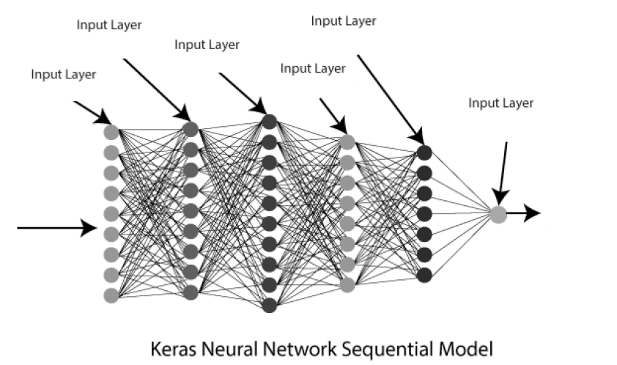
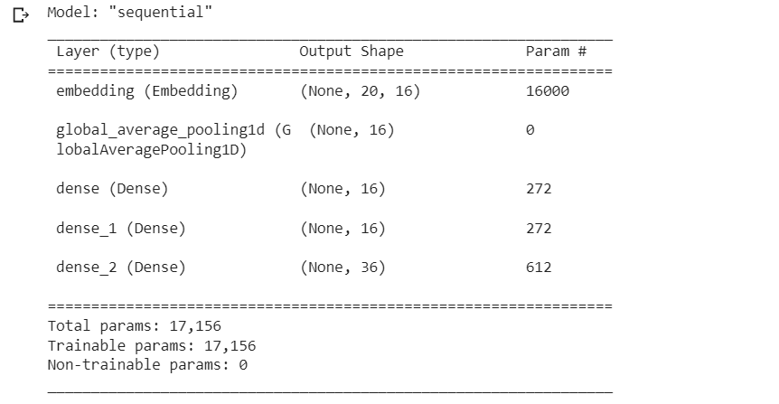
Model Training
The suggested model's neural network architecture is then specified, with Keras' "Sequential" model class being employed. Softmax was employed as the activation function.
It is preferable to dump all needed files after training so that they may be used during inference.
So that the trained model, the fitted tokenizer and the encoder object are all saved.

Slide 14
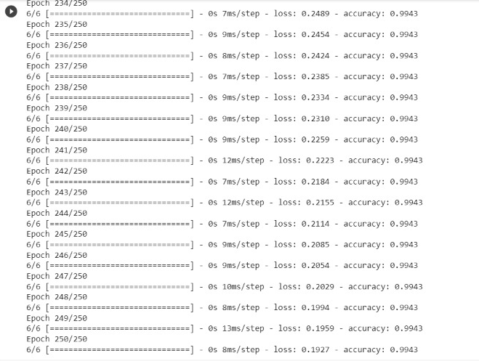
Model Testing & creating the front-end and back-end
When a new user message is received, the chatbot computes the similarity of the new text sequence to the training data. Taking into account the confidence scores obtained for each category, it assigns the user message to the intent with the greatest confidence level.
It is preferable to dump all needed files after training so that they may be used during inference. So that the trained model, the fitted tokenizer and the encoder object are all saved.
The front-end is built with HTML, CSS, and Bootstrap, while the backend is built with Flask.
As a result, the end- to-end project is now completed and is given the shape of a web application.

Slide 15
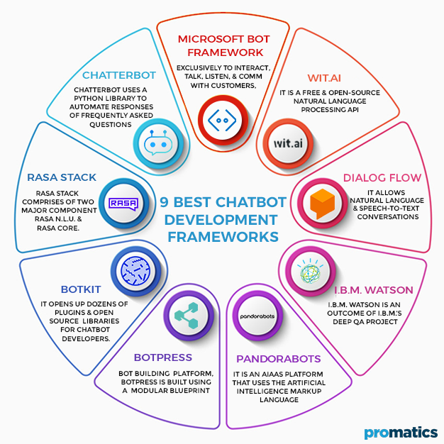
Chatbot framework
For our project - Dialog Flow is chosen.
Can easily work with python with Flask.
If needed Dialog Flow can be integrated with several social media platforms( like - WhatsApp, Telegram etc.)

Slide 16
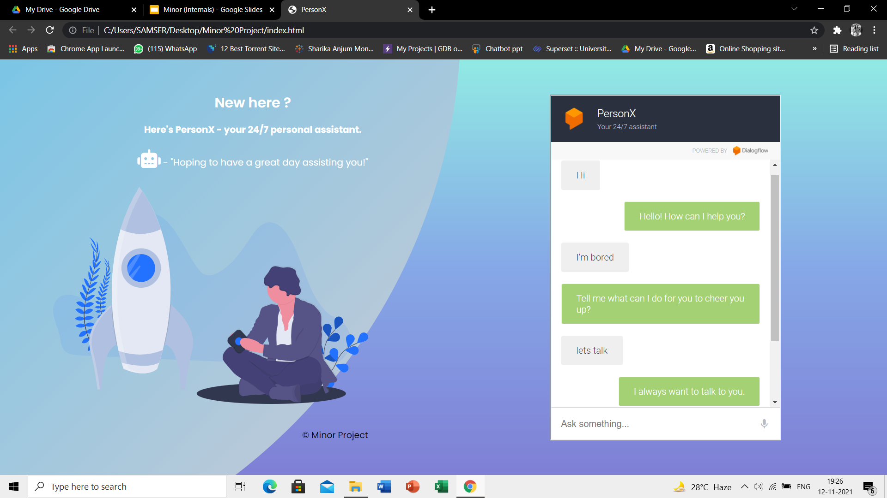
Demo
Running on Localhost

Slide 17

Conclusion

Slide 18

Schedules meeting/Appointment
Mechanized for 24 hours a day
04
01
03
Chatting agent to reduce loneliness
It can take voice queries as input using voice to text extraction feature.
02

Slide 19
THANK YOU

